Slide 1

Examining GA4 dataset in BigQuery and Python
Cameron Webb

Slide 2
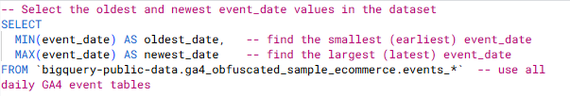
Checking for available dates
Bigquery data extraction
Preliminary testing showed the expected dates (August 1st-7th) of 2020 were not available in the dataset, so first we checked which dates were available.
The following code provides a single row with the oldest date and the newest date:

Slide 3

Output:
Bigquery data extraction
The available dates listed were from November 11th 2020 to January 31st 2021.
December was chosen at random to be the month we proceeded with, and we stuck with the 1st to the 7th as in the original requirements.

Slide 4
The Dataset
Bigquery data extraction
We created two data-frames, first, “events” is all data pulled from the dataset provided.
Second, google analytics has some data stored in arrays, we used a BigQuery function called ‘unnest’ to separate the values into separate rows and store it as “ep” (event parameters)

Slide 5
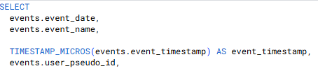
Selecting the data
Bigquery data extraction
  First, we choose what values we want to select, in this case – we want event_date, event_name, event_time stamp converted from milliseconds to a readable format, and the user_pseudo_id

Slide 6
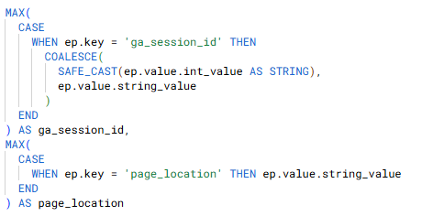
Selecting the Data
Bigquery data extraction
We also select ga_session_id and page_location from the EP dataframe we selected earlier.
The coalesce function is used to avoid Null values being collected by either collecting a string directly from the dataframe, or converting any potential integer values to a string

Slide 7

Filtering By Date
Bigquery data extraction
We use a simple between statement to ensure the data pulled from the dataframe is only from the dates selected (Dec 1st - 7th 2020)

Slide 8

Grouping the DAta
Bigquery data extraction
There is likely to be multiple rows per session because of the nested parameters, so we have grouped the data by date, name, timestamp and pseudo_ID to ensure we get one unique event with all of the attributes

Slide 9

Sorting the data
Bigquery data extraction
Finally, we ordered the data by timestamp, putting in chronological order from oldest to newest, another useful way to sort it may have been to sort it first by

Slide 10
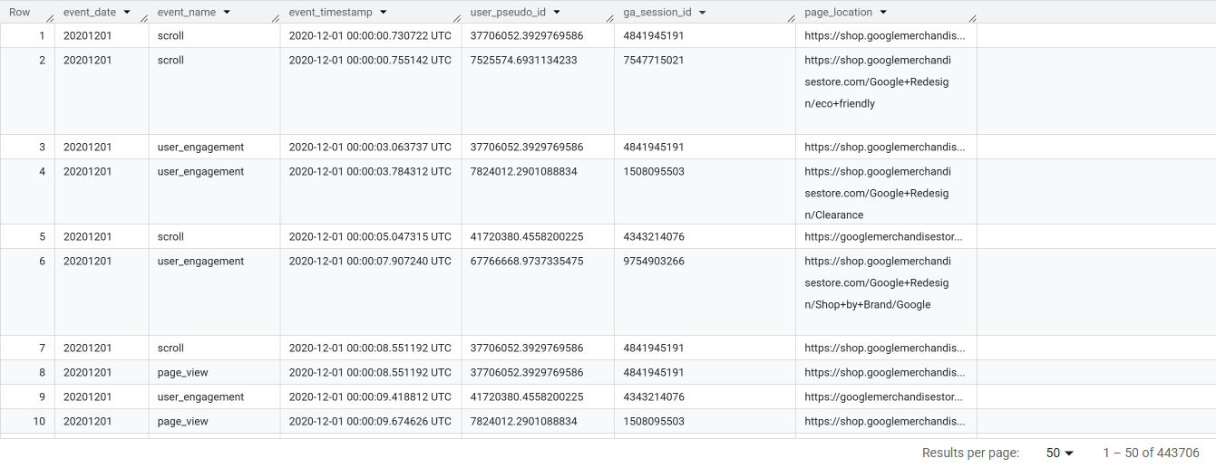
Output
Bigquery data extraction
After running the query, we get a huge output, 443,706 rows of unique events

Slide 11
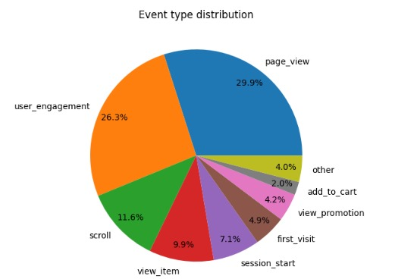
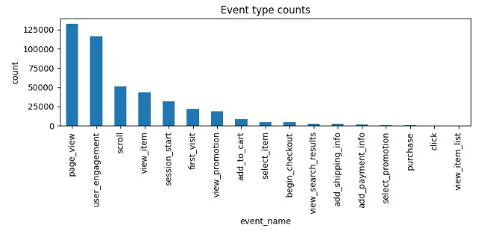
Exploratory Analysis
Bigquery data extraction
We take a quick look at the distribution of event type, looking for anything unusual, everything is fairly standard.
Considerably more people added their shipping and payment info than actually made a purchase.

Slide 12
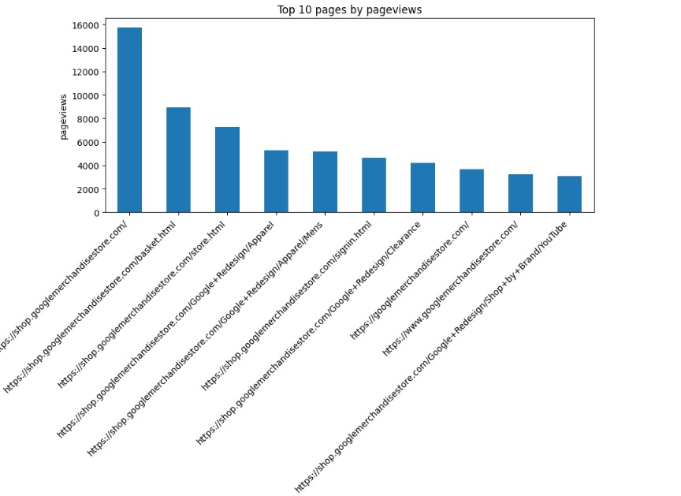
Cont’D
Basket
Home Page
Store Page
Apparel
Men’s
Home Page 2
Sign-in Page
YouTube link
Clearance
Home Page 3
Notably, 3 of the top links are variations of the home page.
Men’s has the 5th highest page view, women’s is not in the top 10
Sign-in is

Slide 13
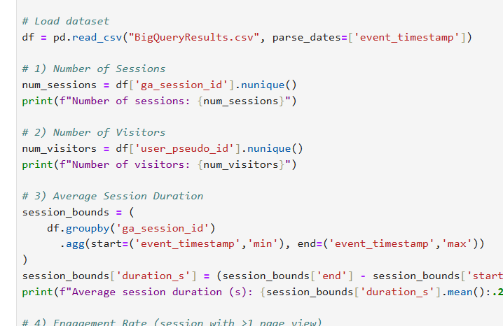
Python Metrics Calculations
1. Number of Sessions
Python code:
This code counts the number of unique google analytics session IDs as a session could have multiple events.
The number of sessions is 31,046.

Slide 14
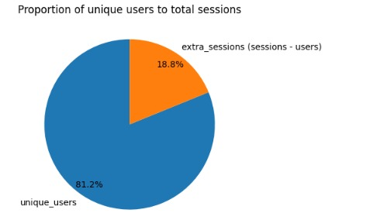
Python Metrics Calculations
2. Number of Visitors
Python code:
This code counts the number of unique user IDs, as a single user could have multiple events. A unique user ID represents a visitor.
The number of visitors is 25,199.
Nearly 19% of sessions were created by visitors who had previous sessions.

Slide 15
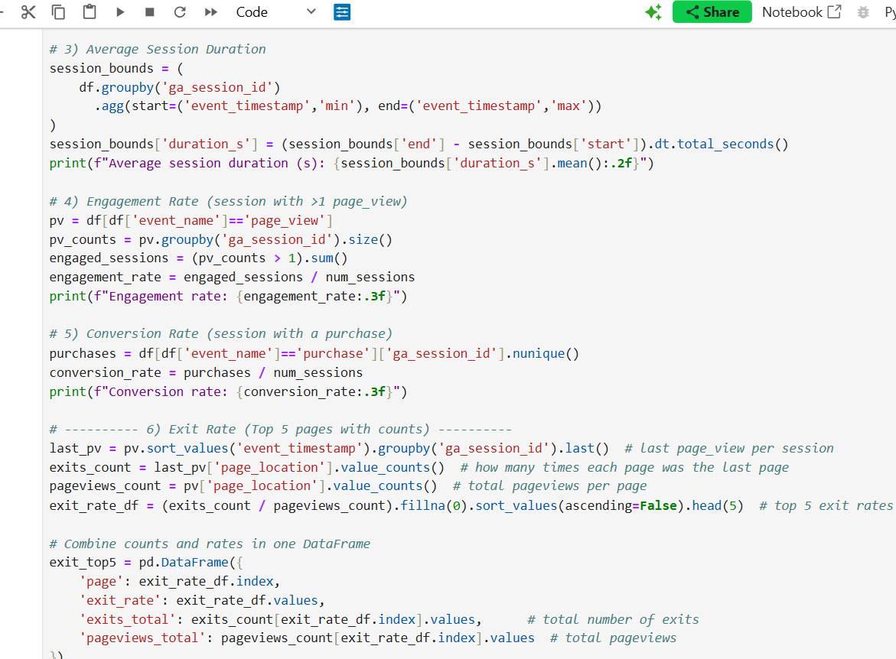
Python Metrics Calculations
3. Average Session Duration
Python code:
We initiated by identifying individual sessions through grouping them by the ga_session_id.
Then, we have to grab the start and finish time by identifying the maximum and minimum timestamp from each unique session.
Next, we can calculate the duration by subtracting the minimum time stamp from the maximum.
Finally, we take the average duration of all the calculated durations
The average session duration 1013.40 seconds

Slide 16
Python Metrics Calculations
4. Engagement Rate
Python code:
First, we create a data frame only containing page views.
Secondly, we count the page views when grouped by ga_session_id.
Next, we count the number of sessions that have more than one page viewed.
Finally, we calculate the engagement rate by dividing the number of sessions >1 page view by the total number of sessions
The engagement rate is 0.437 which is 43.7%.

Slide 17
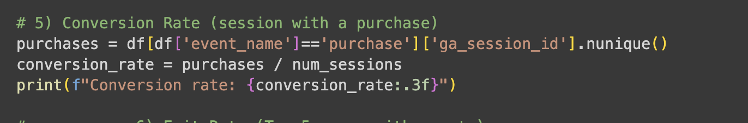
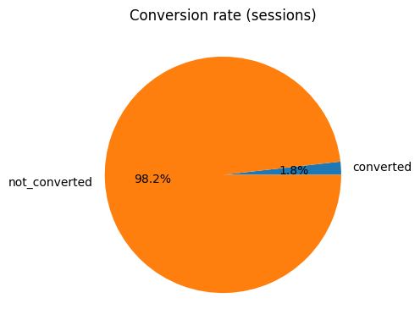
Python Metrics Calculations
5. Conversation Rate
Python code:
The code filters the dataset to where event_name equates to a purchase.
Then uses the .nunique() function on ga_session_id to count the unique number of sessions that include at least one purchase.
Then dividing the total number of sessions resulting in the conversion rate.
The conversion rate is : 0.018 or 1.8%

Slide 18
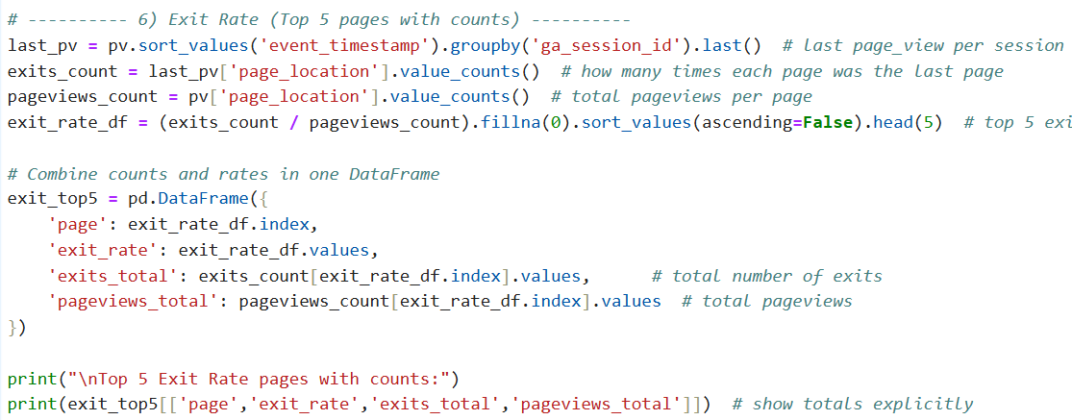
Python Metrics Calculations
6. Exit Rate: Top 5 Pages Cont’d
Python code:
Top 5 Exit Rate pages with counts:
exits_total page exit_rate
https://shop.googlemerchandisestore.com/Google... 100% 2
https://shop.googlemerchandisestore.com/google... 100% 1
https://shop.googlemerchandisestore.com/google... 100% 4
https://shop.googlemerchandisestore.com/google... 100% 1
https://shop.googlemerchandisestore.com/google... 100% 1
Start off by sorting values chronologically and then grouping by sessions. The last() function extracts only the last page view event from each session. This event will have the exit page for each session from the page_location column.
Then, we count how many times a specific page was the last viewed page; the exit page. As well, count the number of views for each page.
Now we have to calculate the exit rate by dividing the number of exits by the number of page visits.
Finally, we have to create a data frame to display the top 5 pages. The variables included are:
Page URL (Identifier too)
Exit rate
Total number of exits from page
Total number of views from that page

Slide 19
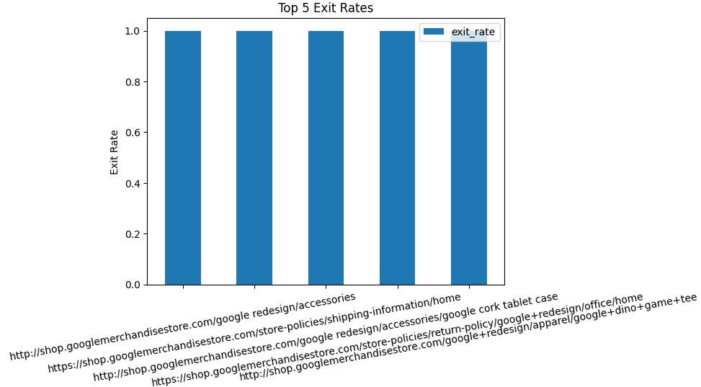


Python Metrics Calculations
6. Exit Rate: Top 5 Pages
Unusually, the top 5 pages with the highest exit rates are all 100% meaning users exited every time they viewed this page.
Upon further inspection we noticed that the number of visits to these pages and the number of exits were all very low, (4 or lower) so they were likely outliers

Slide 20
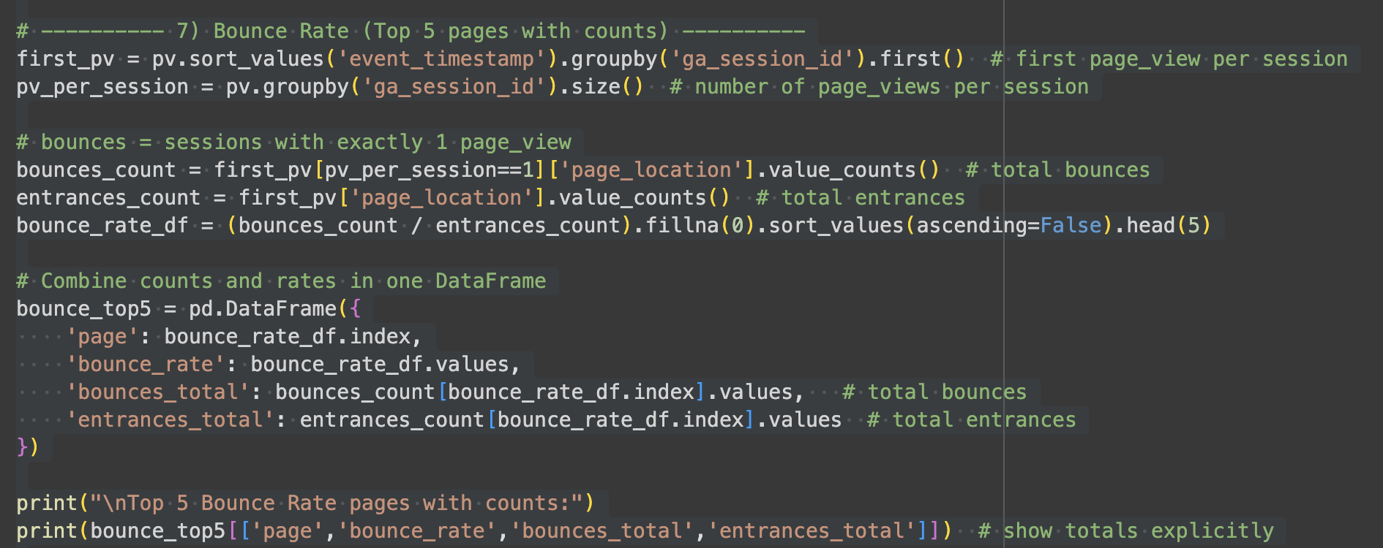
Python Metrics Calculations
7. Bounce Rate
Python code:
Next using pv_per_session == 1 it shows us how many session contain only one page view resulting in a bounce.
Bounce count shows how many times a page was the only page visited, while entrance shows how many sessions started from that page.
Similar to last step we sort all page views chronologically and then grouping them using ga_session_id. By using the .first() we can extract the first page view from each session which shows us the entrance page.

Slide 21
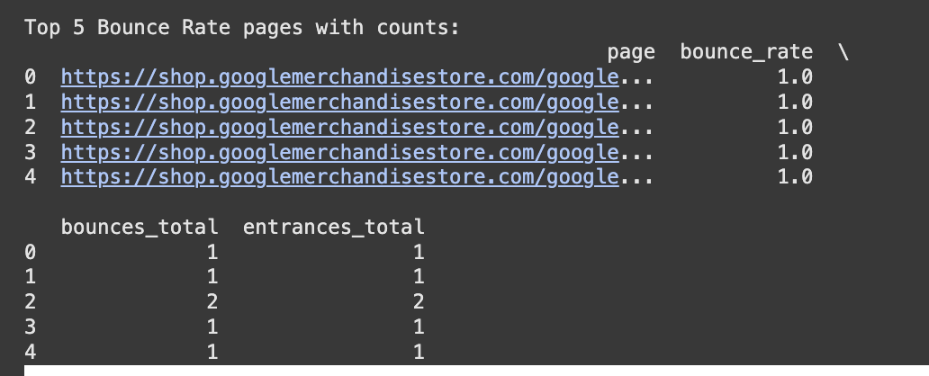
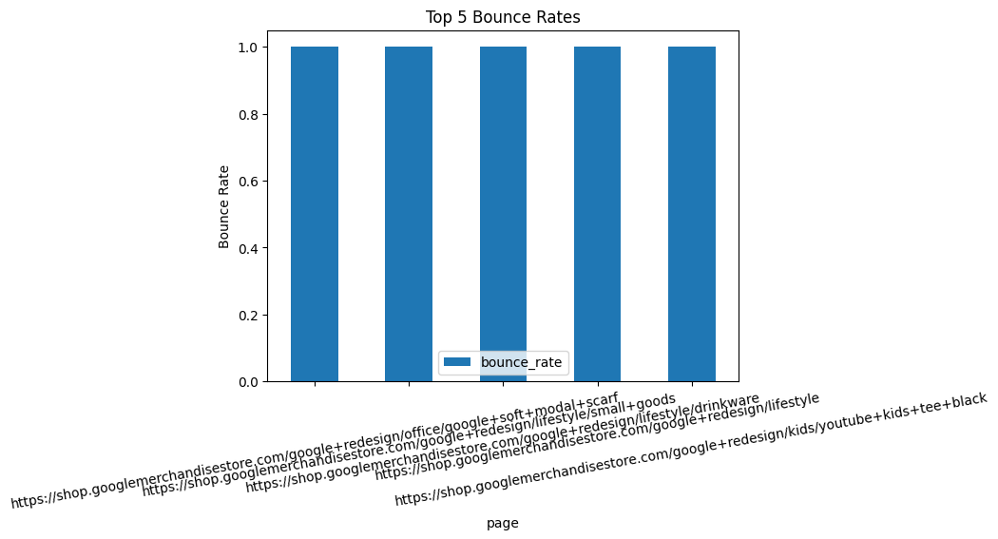
Python Metrics Calculations
7. Bounce Rate Cont.
Python code:
Similarly to the exit rate, bounce rate is 1.0 meaning 100% of users bounced after reaching that page. All top 5 pages have a 1.0 bounce rate with only one or 2 entrances on each page, indicating that these are outliers as well.
In future, we could calculate a more meaningful bounce rate by limiting the minimum number of entrances.

Slide 22
Conclusion
Extracted ecommerce data using GA4 and SQL as a basis to retrieve data through BigQuery
Key metrics were calculated using Python- Sessions :
  31,046 Sessions
  25,199 Visitors
  Avg session duration ~1.013s
  Engagement rate 43.7%
  Conversion rate: 1.8%
Exit and bounce rate analysis revealed some outliers.
Exploratory analysis showed there could be more insights taken from the dataset.

